Slide 1

Employee Data Analysis using Excel…
STUDENT NAME: V MEENAKSHI VERMA
REGISTER NO: 312209521
DEPARTMENT: B.COM BANK MANAGEMENT (BBM)
COLLEGE: Anna Adarsh college For Women

Slide 2
PROJECT TITLE…
EMPLOYEE PERFORMANCE ANALYSIS USING EXCEL.

Slide 3
AGENDA...
PROJECT MANAGEMENT
PROJECT OERVIEW
END USERS
OUR SOLUTION AND PROPOSITION
DATASET DESCRIPTION
MODELLING APPROACH
RESULTS AND APPROACH
CONCLUSION

Slide 4
PROBLEM STATEMENT…
To assess and review employee performance over the past few years, identifying strengths, areas for improvement, and key trends that can inform HR’s Strategic decision.

Slide 5
PROJECT OVERVIEW…
Implementation: Conduct analysis and visualization of employee performance data to identify trends, strengths, and areas for improvement. Determine skill gaps, recommend actions, establish decision-making criteria, and allocate resources effectively. Data Types: Work with numerical, textual, and categorical data. Data Correction: Address missing values, correct inconsistencies, and eliminate duplicates. Data Organization: Structure data in a tabular format. Dashboard: Create an interactive dashboard using Excel’s pivot tables and charts to provide a dynamic view of the data. Summary: Prepare a report highlighting key findings, visualizations, and actionable insights.

Slide 6
WHO ARE THE END USERS…
Business Analyst Accountant Student and Educator Data Analyst Project Manager Sales and Marketing Specialist Human Resources Specialist Engineer

Slide 7
OUR SOLUTION AND ITS VALUE PROPOSITION…
Conditional Formatting: Highlight missing values. Filter : Exclude or remove unwanted data. Formula : Generate a summary or perform calculations. Graph: Create data visualizations.

Slide 8
DATA DESCRIPTION …
Employee Data Source: Kaggle Total Number of Features: 26 Selected Features: 9 Employee ID: Numerical data First Name: Textual data Last Name: Textual data Business Unit: Textual data Employee Status: Textual data Employment Date: Textual data Gender Code: Textual data Current Employee Rating: Categorical data Performance Level: Textual data

Slide 9
THE WOW IN OUR SOLUTION …
. Interactive Dashboard: Develop a dynamic dashboard using Excel’s Pivot Tables, incorporating slicers and interactive charts. This enables stakeholders to navigate the data seamlessly.
. Automated Reporting: Leverage Excel for automated reporting, optimizing resource use and enhancing efficiency in data management. . Employee Growth Trajectory Visualization: Create performance and growth charts for each employee, highlighting their progress over time. This visualization motivates employees by showcasing their development and gives managers a clear overview of overall performance. . The WOW Factor: The WOW factor lies in transforming raw data into insightful and interactive performance analyses. This facilitates decision-making, encourages and motivates employees, and drives continuous growth across the organization.

Slide 10
MODELLING …
Define Key Performance Indicator (KPIs)
Identify Metric : Determine the KPIs that reflect employee performance . This include:
Business unit Employee status Employee type Current Employee rating

Slide 11
Data Collection and organization Data source : Collection of data from various sources Data structure: Organization of the data in Excel with the following columns ( as an example ) Employee ID First Name Last Name Business Unit Employee Status Employee type Performance level This data should be laid out in structured table format for an easy analysis.

Slide 12
Data cleaning and presentation Handle Missing data : Using Excel function to fil the missing data . Performance Dashboard Interactive Dashboard: Using Slicers and Pivot table to create a interactive performance . Data Visualization Pivot table and pivot Chart: Create pivot table to summarize data by Department, Job role , it can also summarize into bar graph & charts. Trend Analysis: Usage of line Chart to visualize performance level

Slide 13
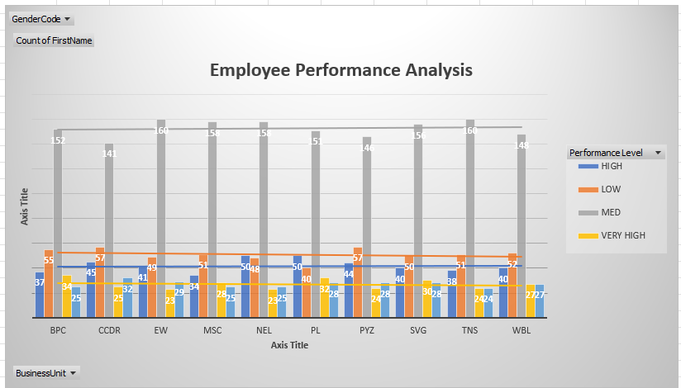
RESULT…

Slide 14
CONCLUSION…
Employee performance analysis using Excel provides a versatile and powerful solution for addressing challenges such as organizational assessments, enhancing employee productivity, and improving effectiveness. Excel’s robust features, including data analysis tools, visualization capabilities, and automation options, make it an invaluable tool for transforming raw performance data into actionable insights

